Slide 1
Applied Data Science
Week 10 – Data Engineering

Slide 2
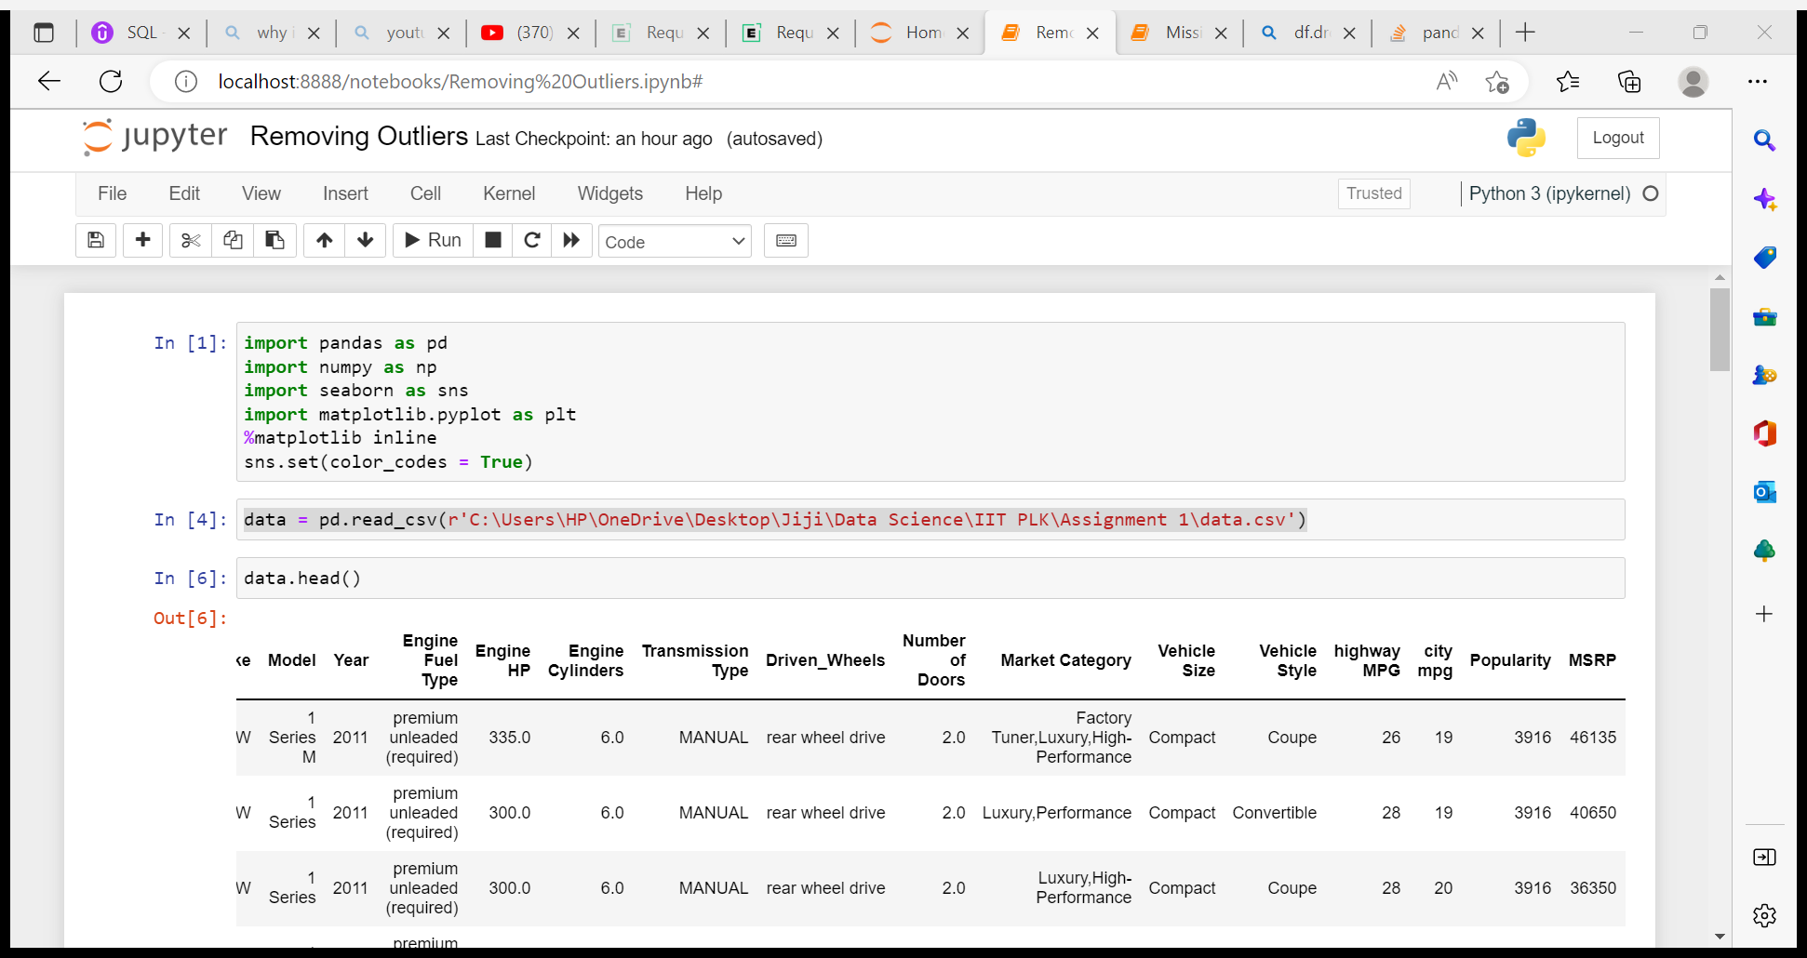
Import Packages
The below are the important Libraries used for this assignment.

Slide 3
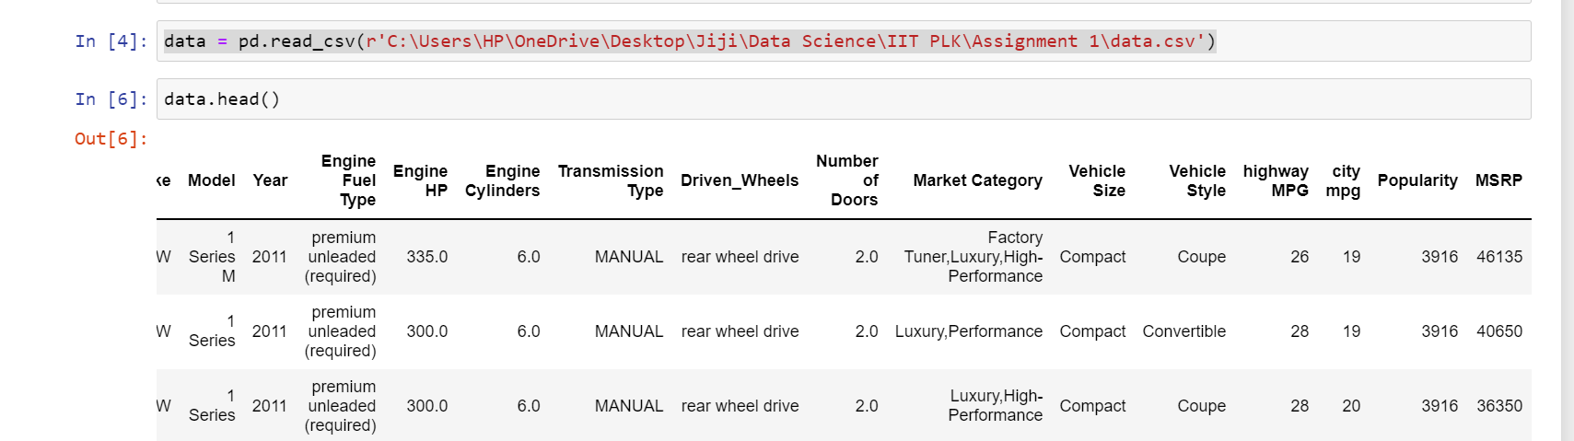
Create Dataframe
Creating data frame with importing CSV file.

Slide 4
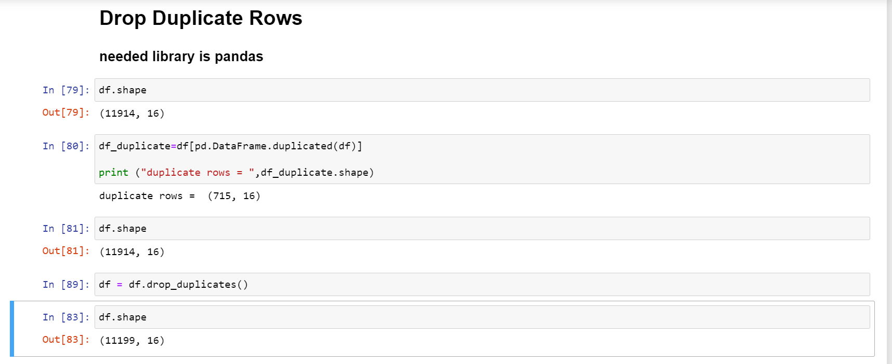
Drop Duplicate Rows

Slide 5
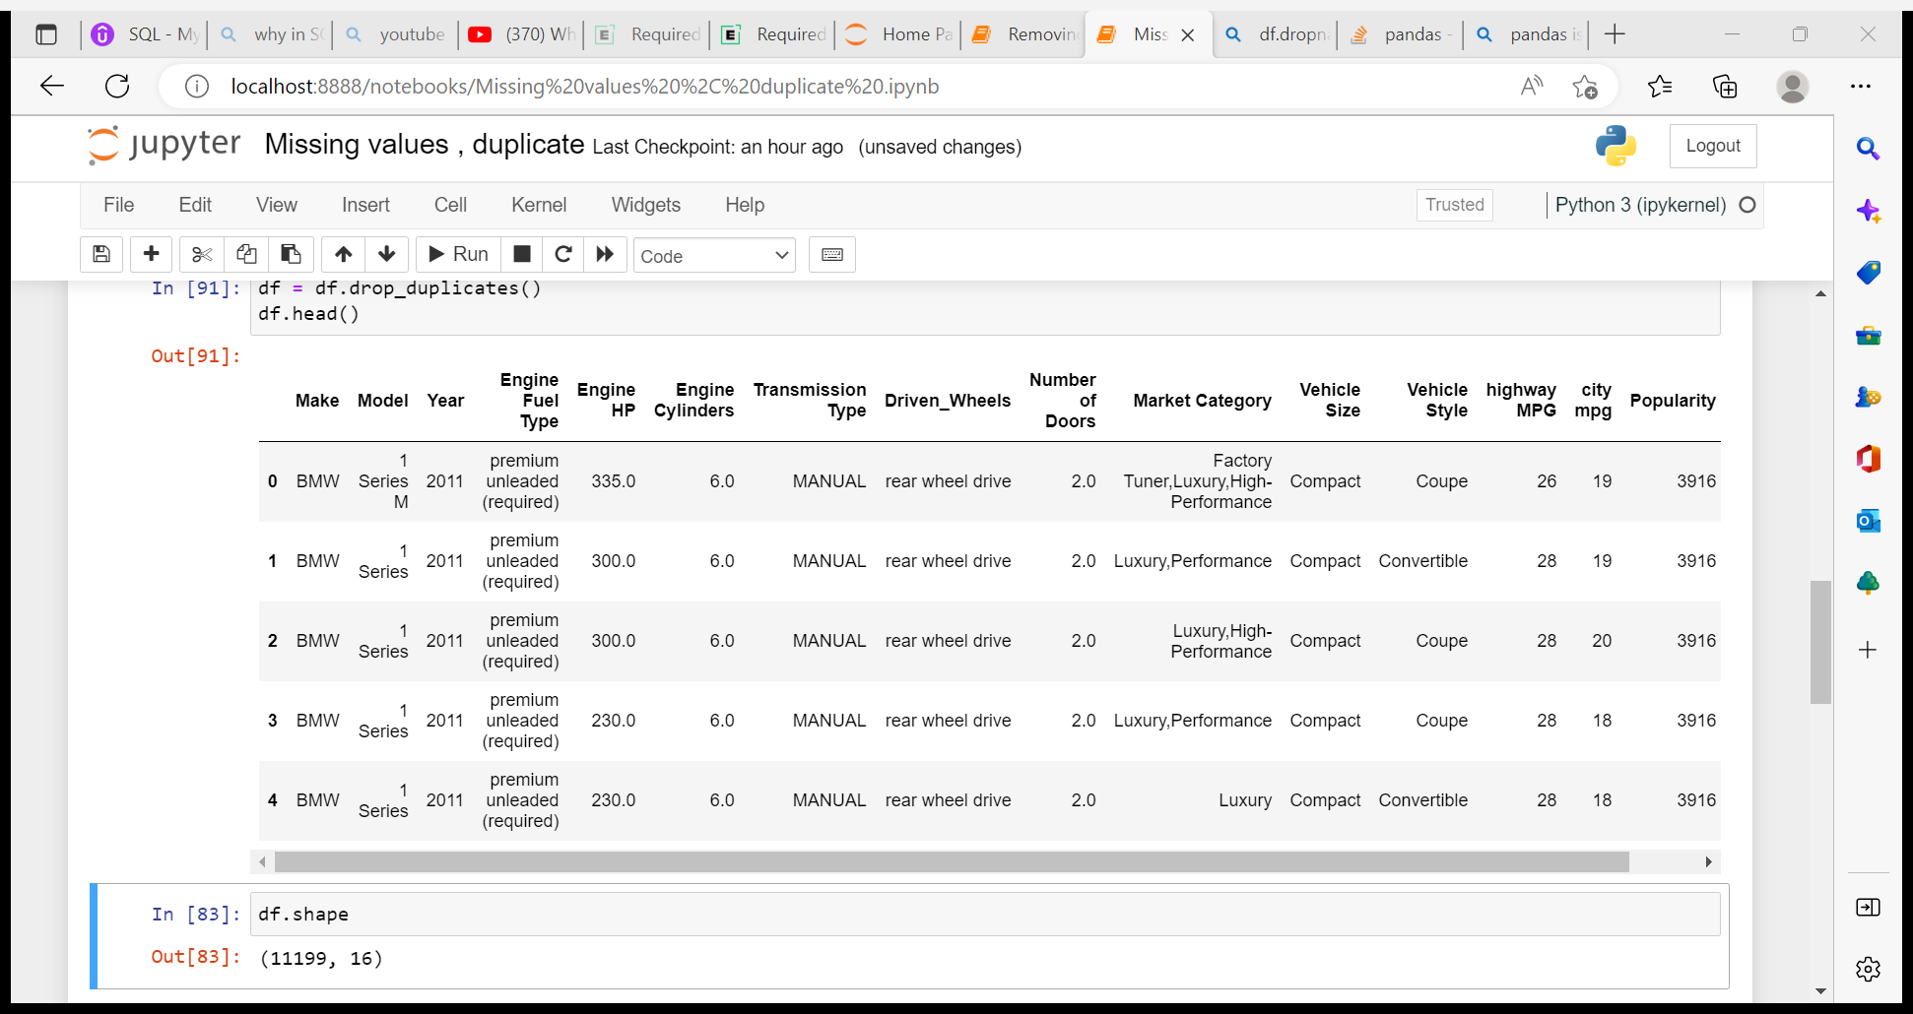
Drop Duplicate Rows
Dataframe after removing the duplicates

Slide 6
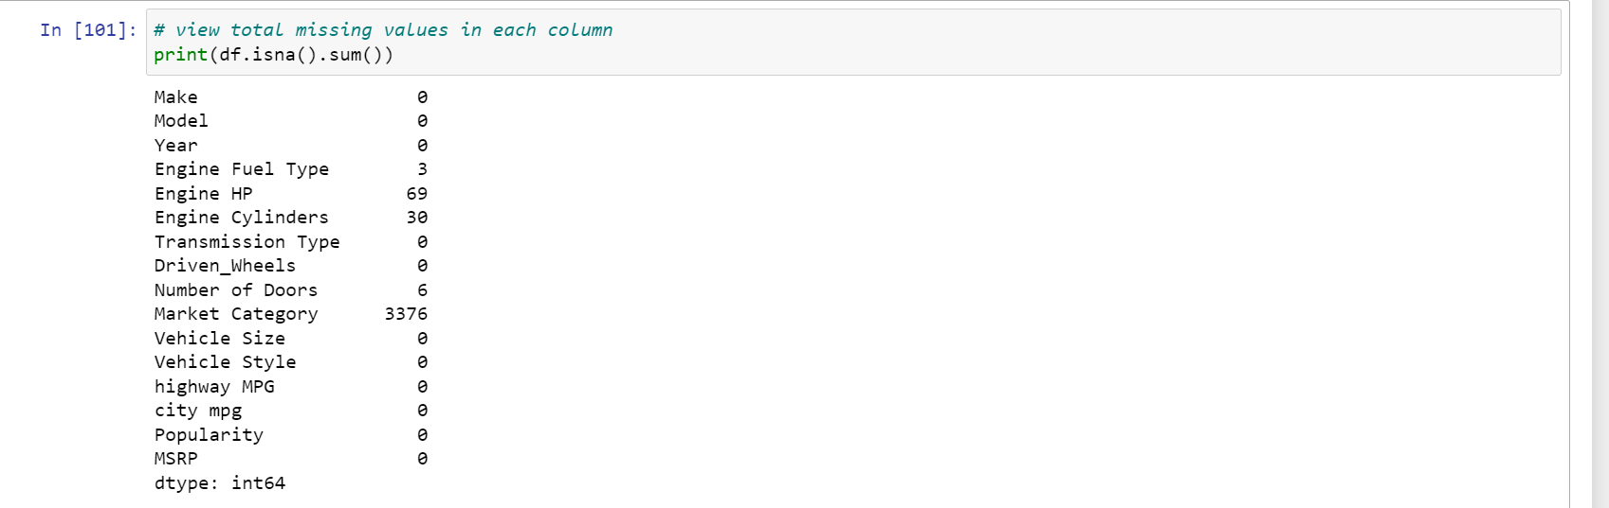
Drop Missing Values

Slide 7
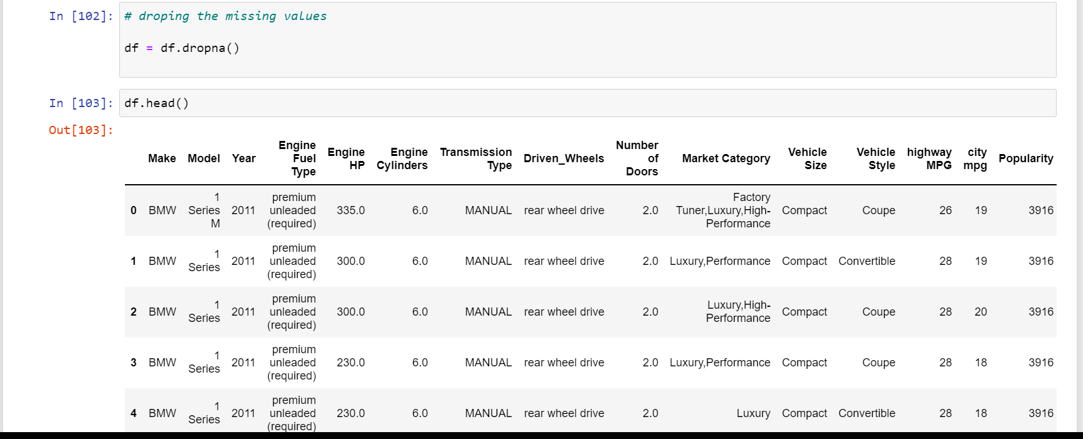
Drop Missing Values

Slide 8
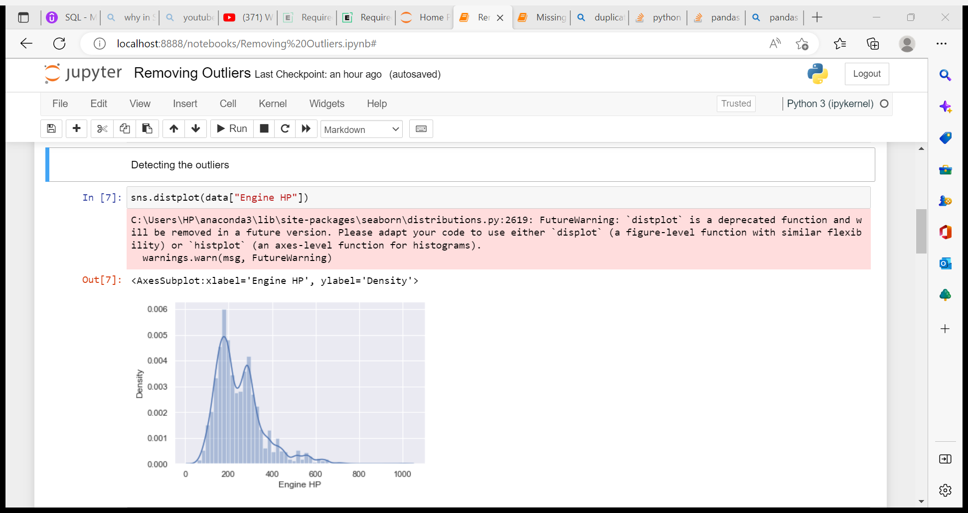
Detect Outliers for ‘HP’ Columns

Slide 9
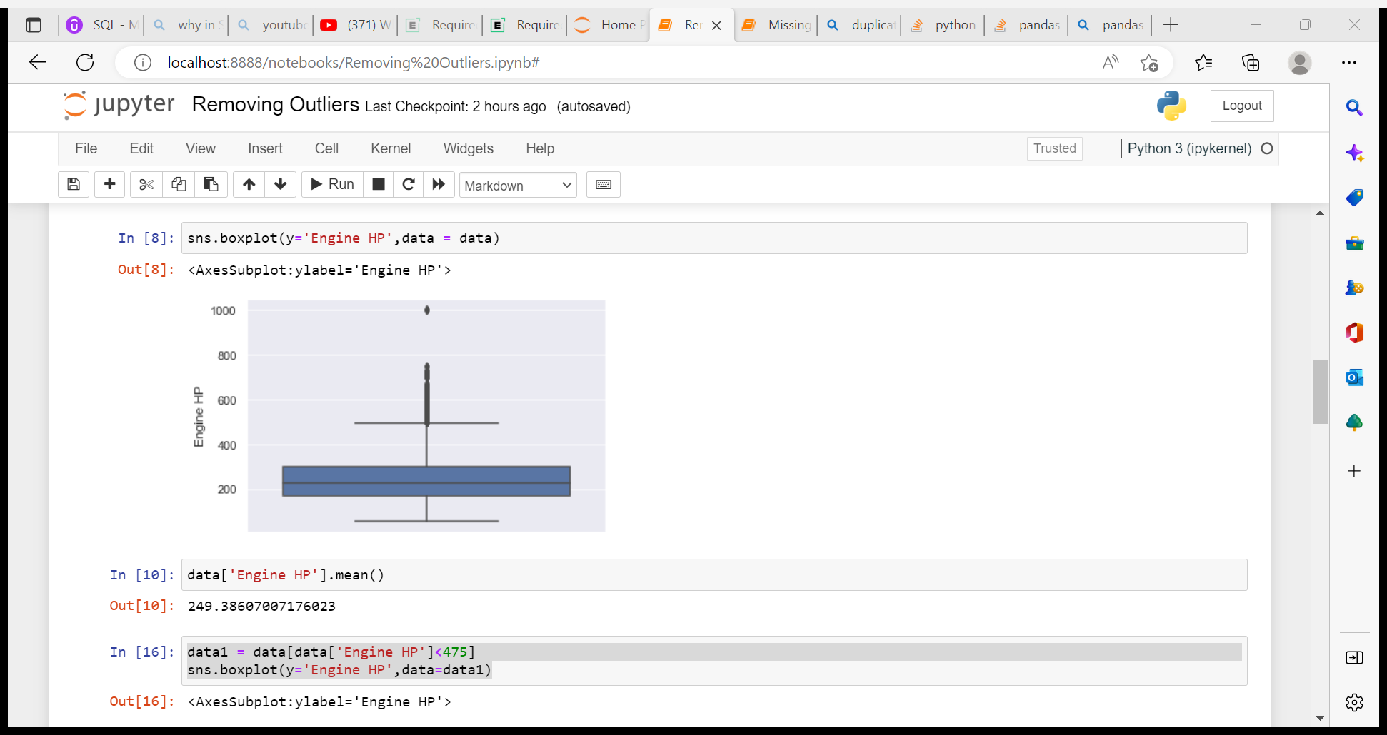
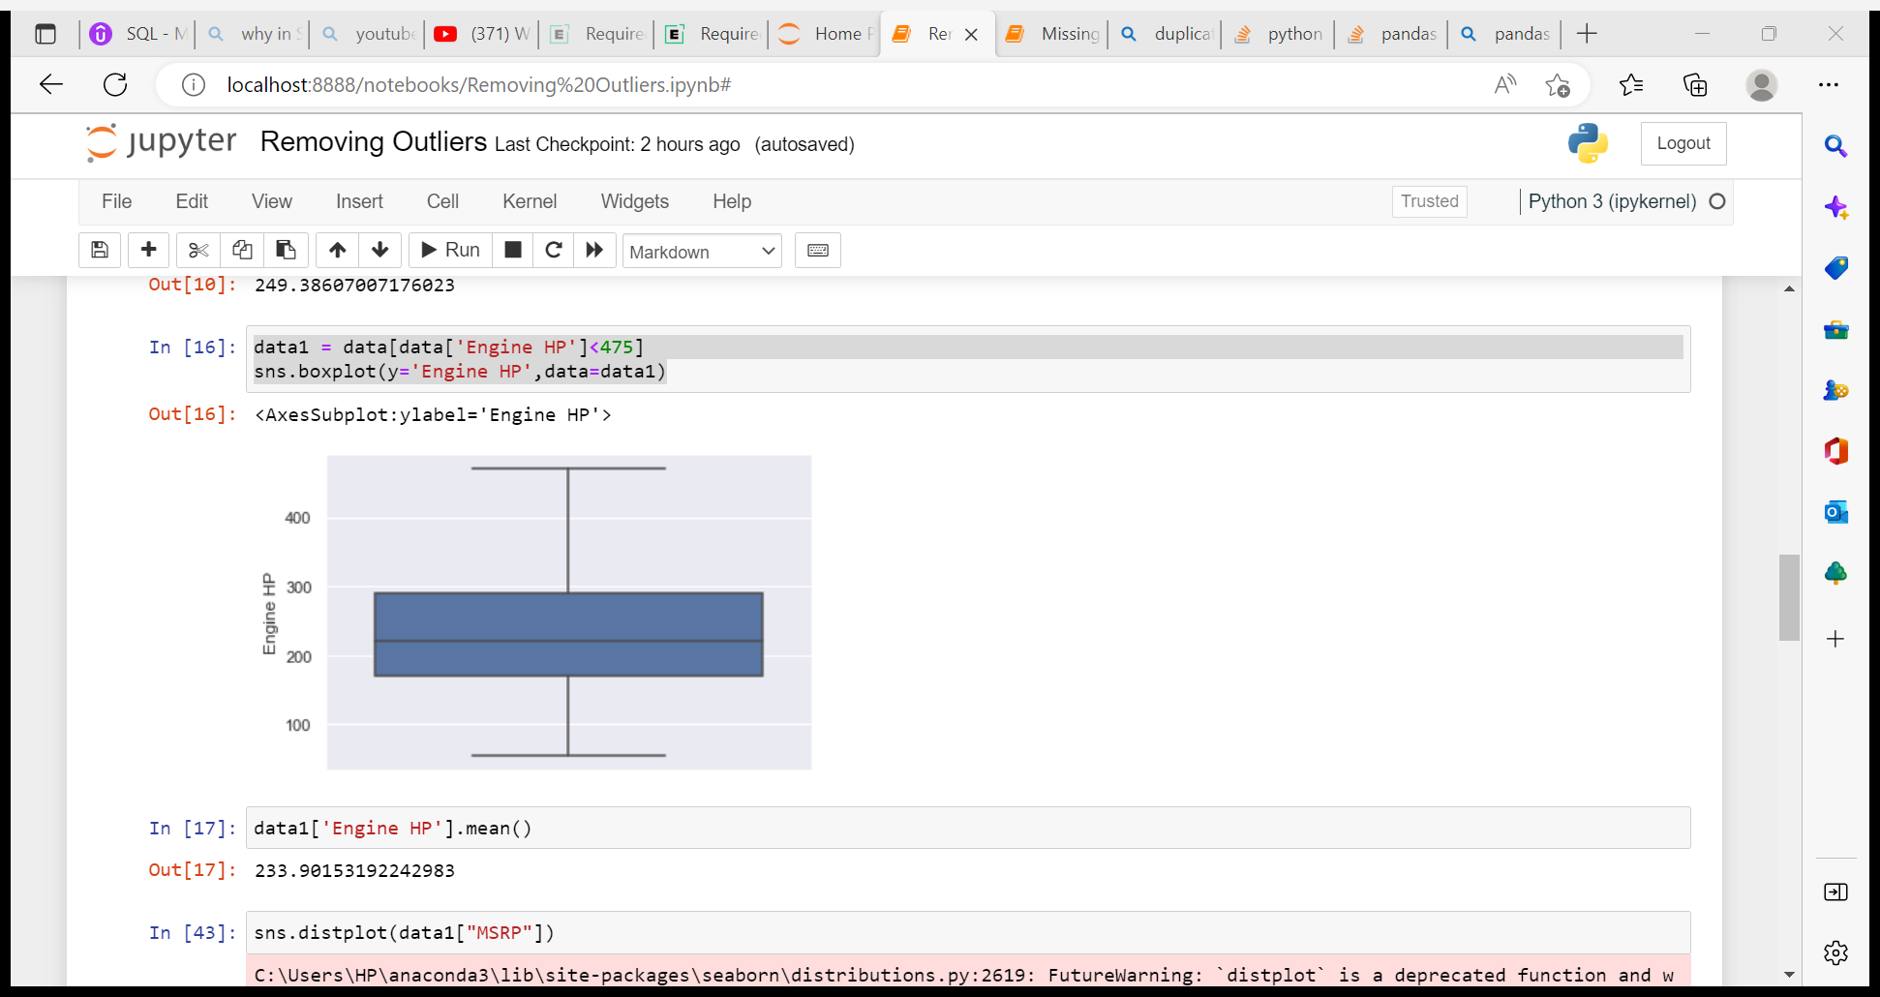
Detect Outliers for ‘HP’ Columns
With outliers
After removing outliers

Slide 10
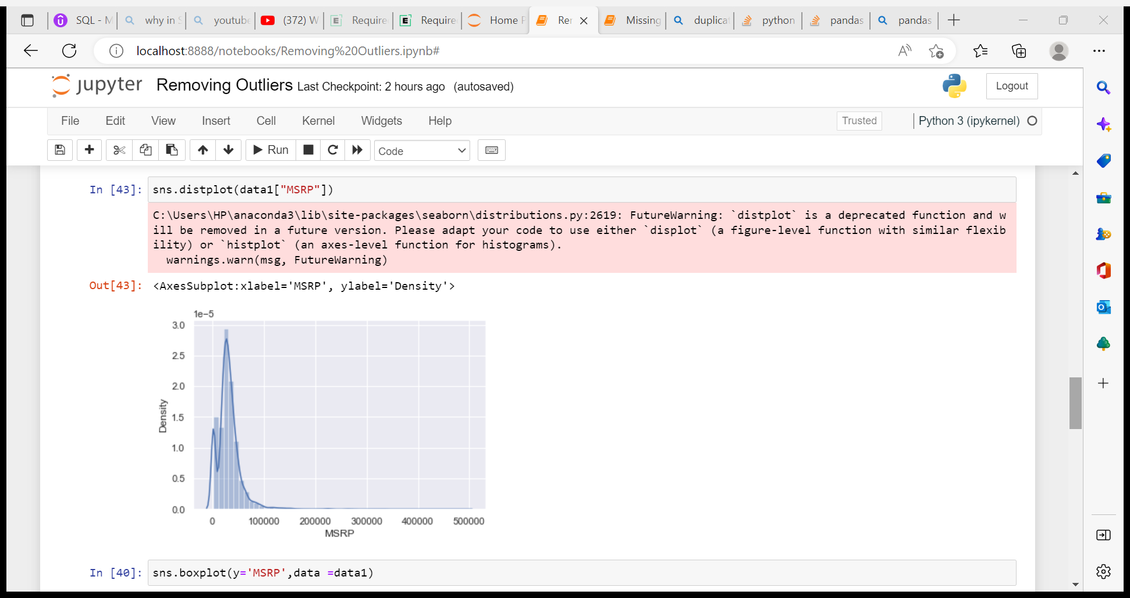
Detect Outliers for ‘PRICE’ Columns

Slide 11
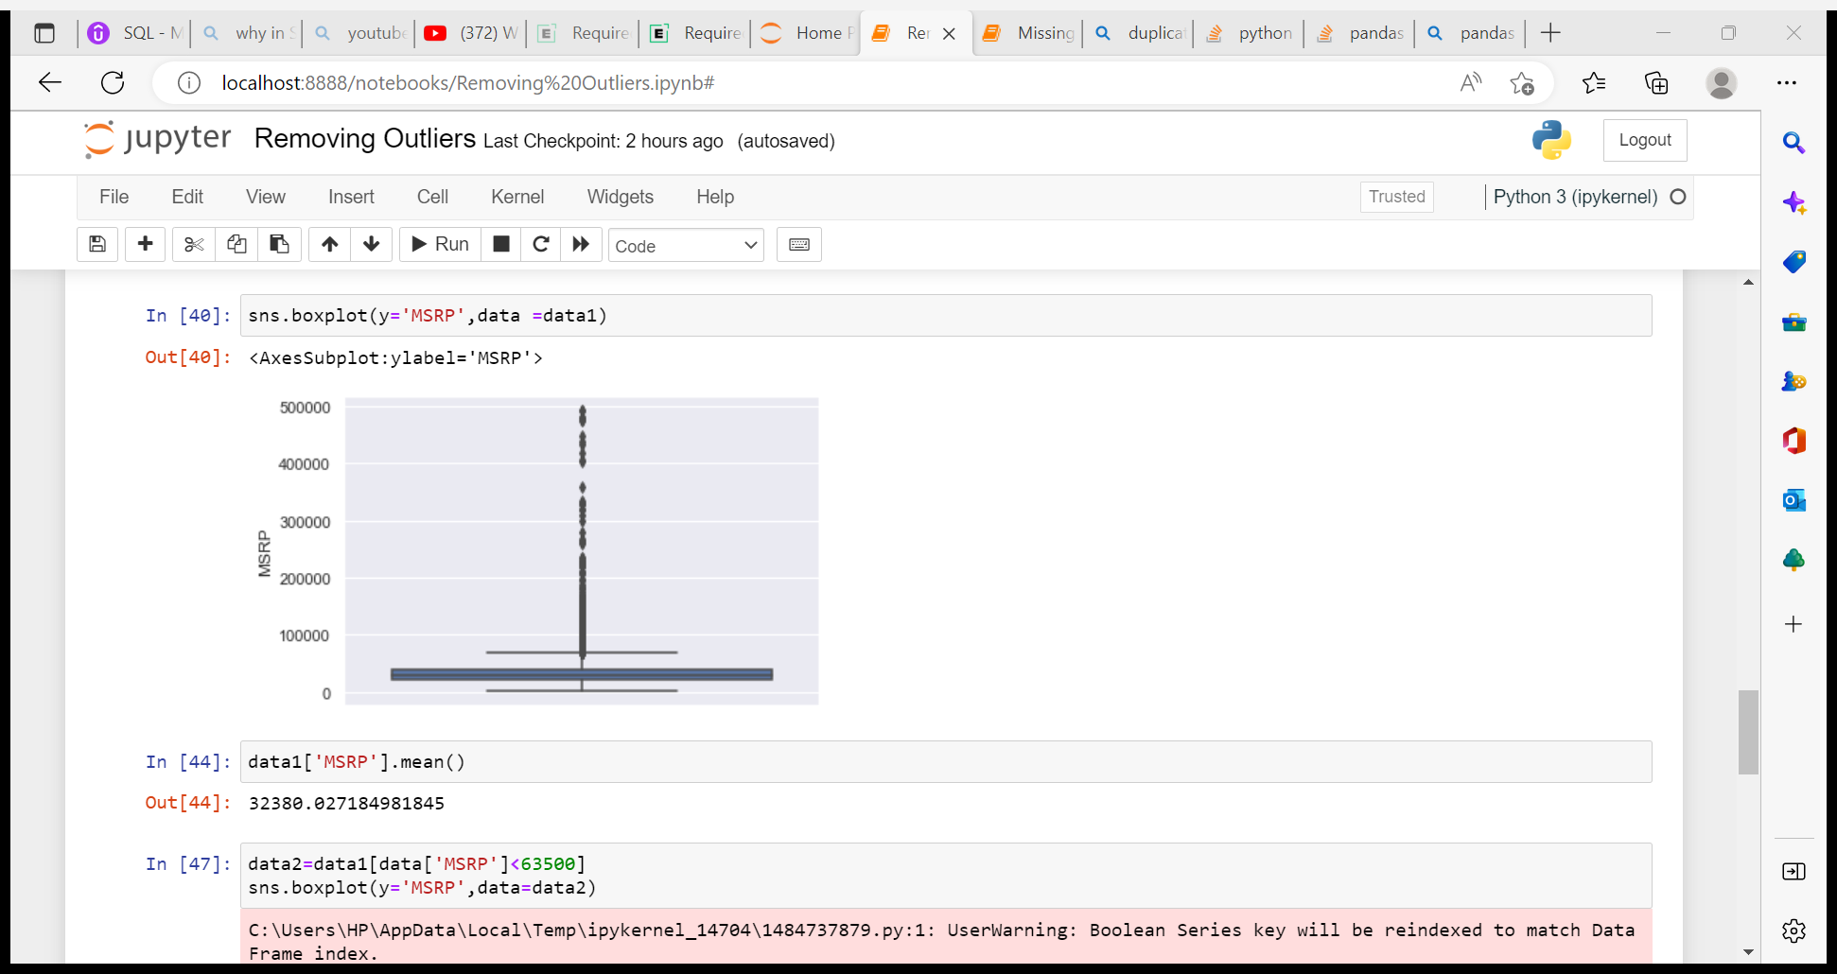
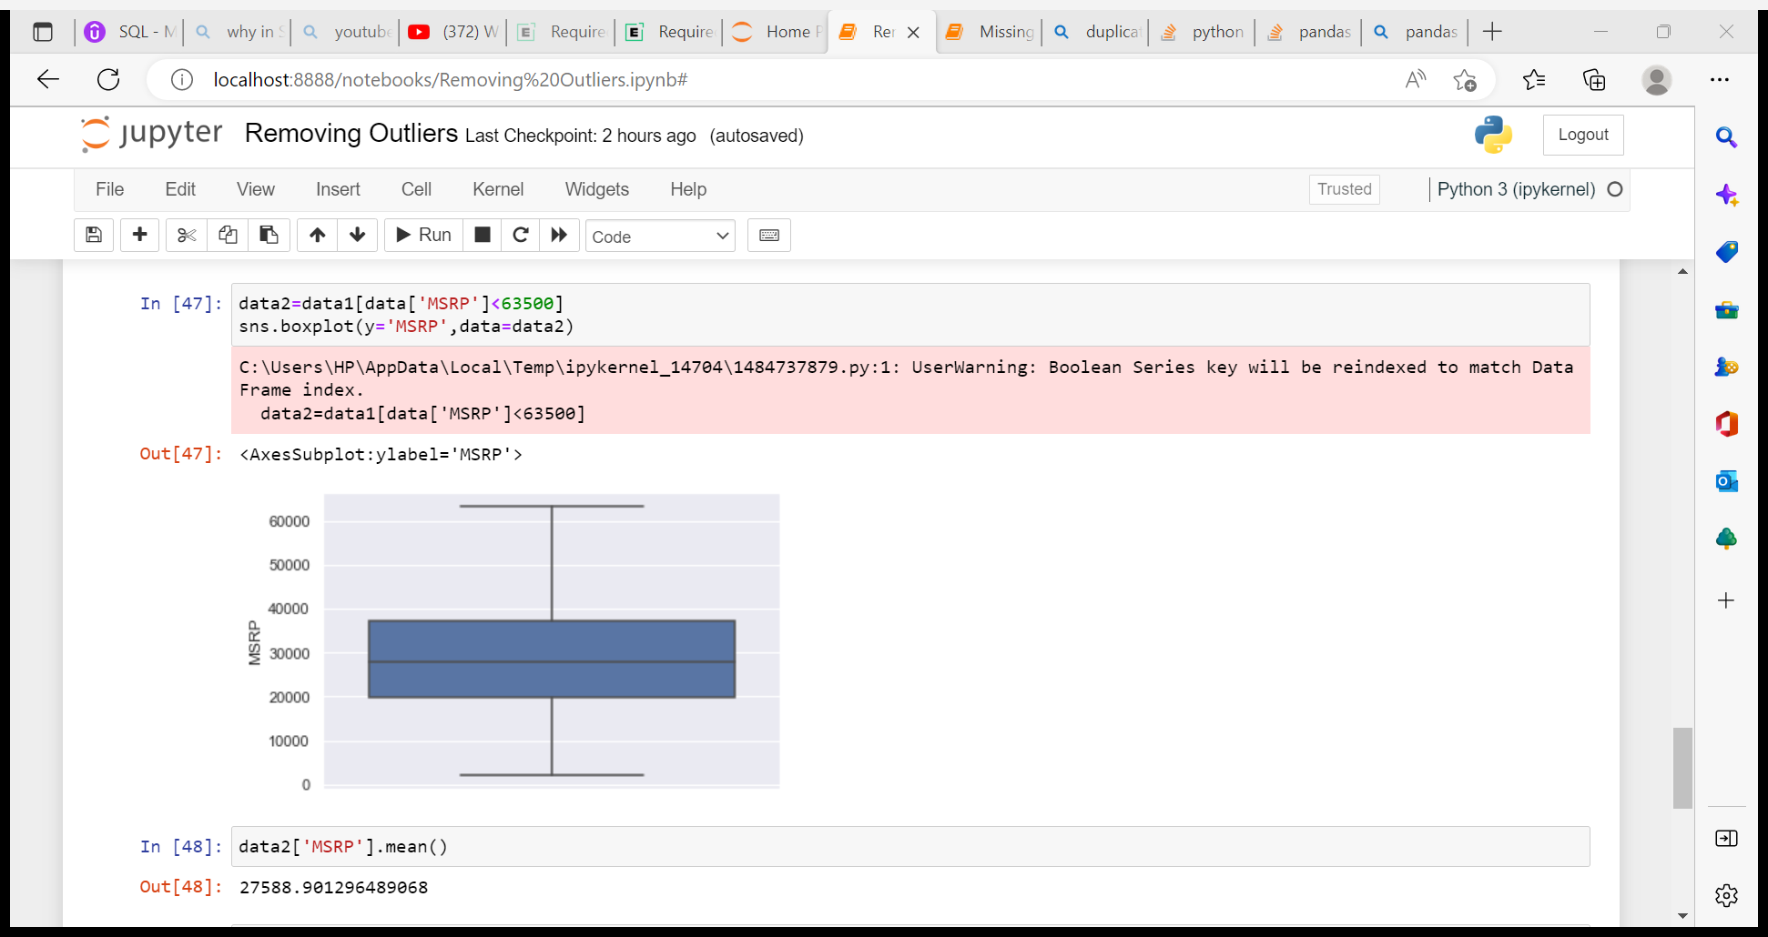
Detect Outliers for ‘PRICE’ Columns
With outliers
After removing outliers

